Slide 1

Data Structures & Algorithm
Stack Data Structure

Slide 2
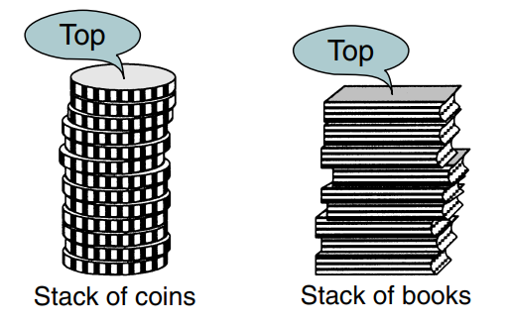
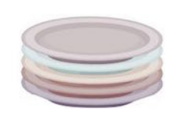
Introduction
A stack is a linear list in which all additions and deletions are restricted to one end, called the top.
Stack of plates

Slide 3
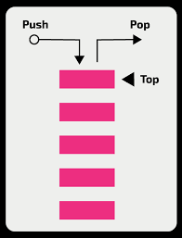
Stack
Last in–first out (LIFO) data structure.
Ex: If you insert a data series into a stack and then remove it, the order of the data is reversed.
Data input as {5, 10, 15, 20} is removed as {20, 15, 10, 5}.

Slide 4
Basic stack operations
Push()
Insert data into the stack.
Pop()
Removes data from a stack and returns the data to the calling module.

Slide 5
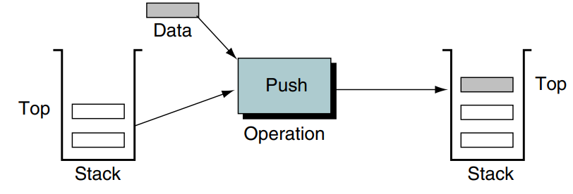
Push
Push adds an item at the top of the stack.

Slide 6
Push
The only potential problem with this operation is that we must ensure that there is room for the new item.
If there is not enough room, the stack is in an overflow state and the item cannot be added.

Slide 7
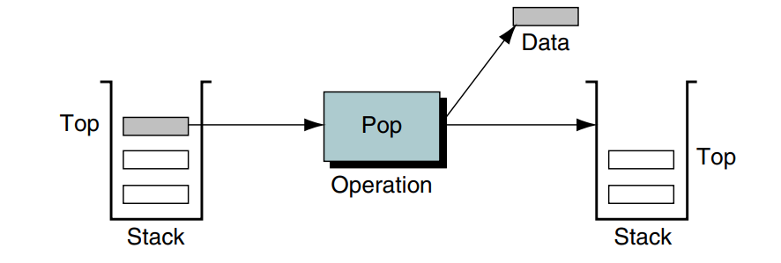
Pop
Remove the item at the top of the stack and return it to the user.

Slide 8
Pop
When the last item in the stack is deleted, the stack must be set to its empty state.
If pop is called when the stack is empty, it is in an underflow state.

Slide 9
Additional stack operations
peek/top()
Get the top data element of the stack, without removing it.
isFull()
Check if stack is full.
isEmpty()
Check if stack is empty.

Slide 10
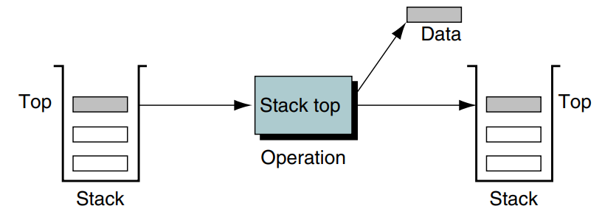
Top
Stack top copies the item at the top of the stack; that is, it returns the data in the top element to the user but does not delete it.

Slide 11
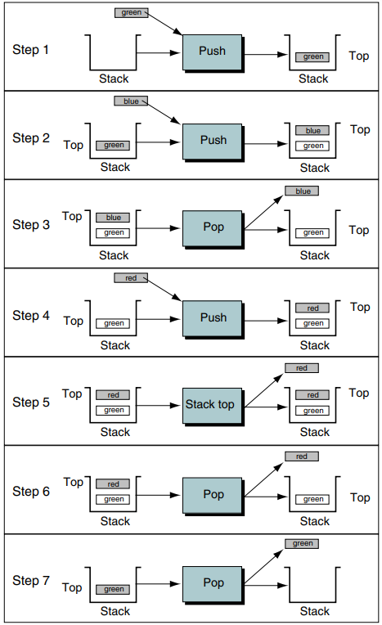
Example
push(green) -> push(blue) ->
pop() -> push(red) ->
top() -> pop() ->
pop()

Slide 12
Stack Implementation
Using Arrays
Using Linked List

Slide 13
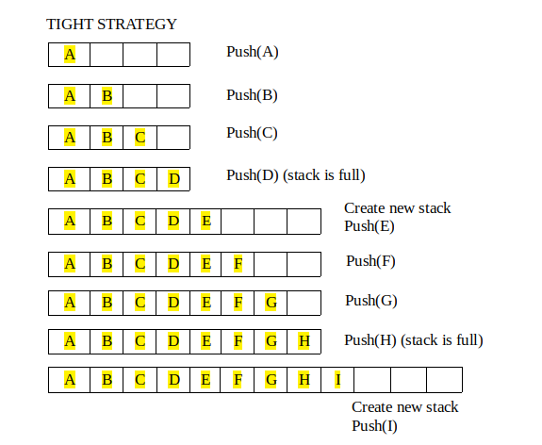
Stack Implementation using Arrays

Slide 14
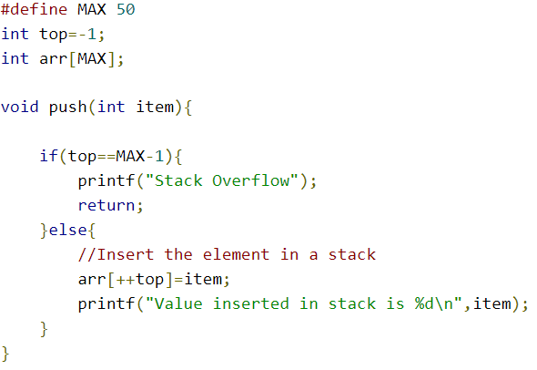
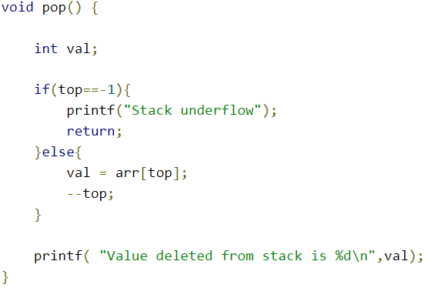
Stack Implementation using Arrays

Slide 15
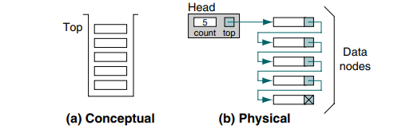
Stack Implementation using Linked List
To implement the linked list stack, need two different structures,
a head and a data node.

Slide 16
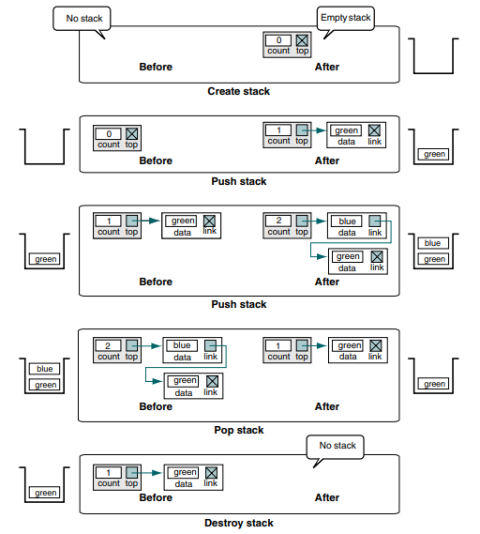
Stack operations

Slide 17
Push
Allocate a node from dynamic memory.
Once the memory is allocated, simply assign the data to the stack node and then set the link pointer to point to the node currently indicated as the stack top.
Update the stack top pointer and add 1 to the stack count field.

Slide 18
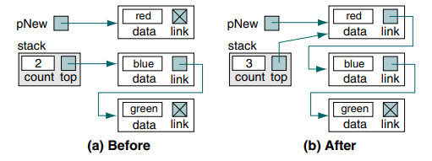
Push

Slide 19
Pop
Pop stack sends the data in the node at the top of the stack back to the calling algorithm.
It then adjusts the pointers to logically delete the node.
After the node has been logically deleted, it is physically deleted by recycling the memory, that is, returning it to dynamic memory.
After the count is adjusted by subtracting 1.

Slide 20
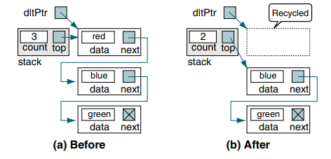
Pop

Slide 21
Applications of Stack
Balanced Parenthesis.
Back button in browsers.
Reverse a word.
Backtracking.

Slide 22
Thank You

